Slide 1
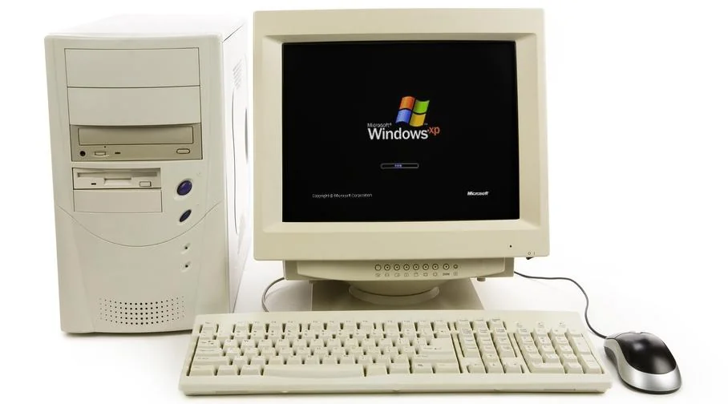
Resume Website
Lydia TerBeek

Slide 2
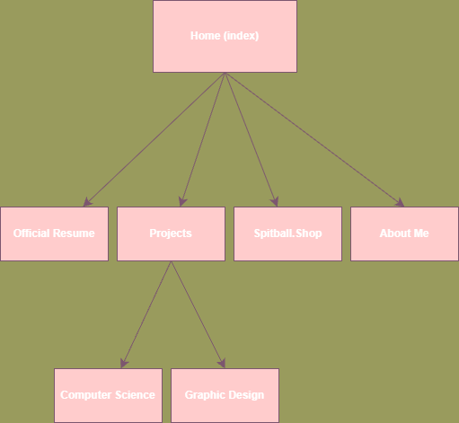
Wireframe
Home
Cutesy navigation – still image with selectable things
Spotify API
Spinitron API
Connect with me! Email, github, Instagram (?)
Official Resume
My official Resume
Resume information expanded upon and professionally formatted
Projects
Computer Science Projects
Graphic Design adventures
Spitball
Small business
DJ Things
About
- Bio, FAQs, Contact (again)

